Slide 1
Implementing automation practices using Azure OpenAI

Slide 2
Deploy app resources
Exercise 1

Slide 3







Exercise 1 Architecture
Contoso Suites Environment
Resource Group
Local Machine
Storage Account
Cosmos DB
Visual Studio Code
Anaconda Python
AI Search
Azure OpenAI
Git
Notes:
Exercise 1 will focus on preparing two separate environments: an Azure resource group containing necessary services, and a local machine with the development resources needed for this training.
You will be given a Bicep script in task 1 that builds out a storage account, Cosmos DB instance, and AI Search service in a resource group you create. Then, in task 3, you will manually create an Azure OpenAI service.
In the meantime, task 2 covers the installation of local tools. We recommend having Visual Studio Code and the Anaconda distribution of Python installed. You can get by with a standard version of Python 3.10 or later, though you may need to install some dependencies separately if you go with a standard Python installation.

Slide 4
Introduction: Deploy app resources
In this lab, you’ll set up a development environment in Azure and on your local machine
After completing this lab, you’ll be able to:
Deploy a Bicep script to build Azure resources
Create an Azure OpenAI Service resource
Install Python and necessary Python packages on a local machine
Notes:
Speaker notes:
In this exercise, you will lay the groundwork for Azure OpenAI integration by deploying out a series of Azure resources and ensuring your local machine has the appropriate software installed.
Learning objectives
After completing this lab, you'll be able to:
Deploy a Bicep script to build Azure resources
Create an Azure OpenAI Service resource
Install Python and necessary Python packages on a local machine

Slide 5
A Brief Introduction to Azure OpenAI
REST API access to OpenAI language models
Handles a variety of natural language-based tasks
Users access via REST API, Python SDK, or web-based interface in Azure OpenAI Studio
Works through prompts and completions
Prompt: Text input sent to a model deployment
Completion: resulting output from the model deployment
Notes:
Speaker notes:
Azure OpenAI Service provides REST API access to OpenAI's powerful language models, including the GPT-4, GPT-4 Turbo with Vision, GPT-3.5-Turbo, and Embeddings model series. These models can handle tasks such as content generation, summarization, image understanding, semantic search, and natural language to code translation. Users can access the service through REST APIs, Python SDK, or a web-based interface in the Azure OpenAI Studio.
Regardless of the specific model you choose, there is a common pattern for Azure OpenAI interaction. You create a prompt, which is a text input. The model deployment you send this text to will interpret the text and perform some action. The output of that action is also known as a completion. Sometimes, the prompt may also include an audio or image input.
We will build a variety of prompts throughout this training and see some of the various results we can get via chat completions.

Slide 6
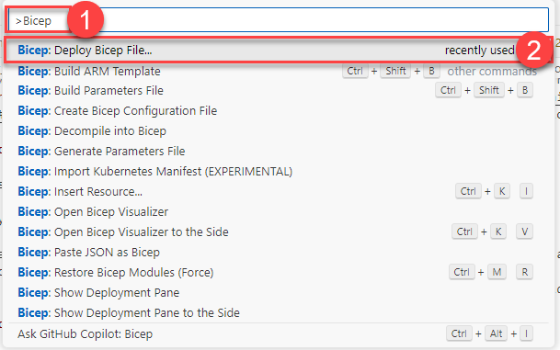
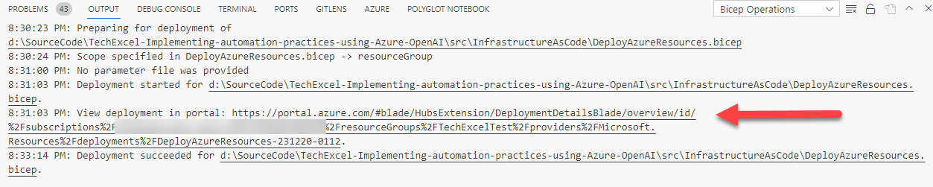
Deploy a Bicep script
Notes:
Speaker notes:
In the first task of this exercise, you will deploy a set of resources to Azure using a Bicep script. One easy way of running a Bicep script is to use the Bicep extension in Visual Studio Code. From there, you can open a Bicep script (file in .bicep format) and deploy it using the Bicep: Deploy Bicep File… command in VS Code. It will ask you for a few pieces of information, such as the deployment name, subscription, resource, group, and parameter file. Then, it will submit the script to Azure and provide you a link to monitor the results of the deployment.

Slide 7
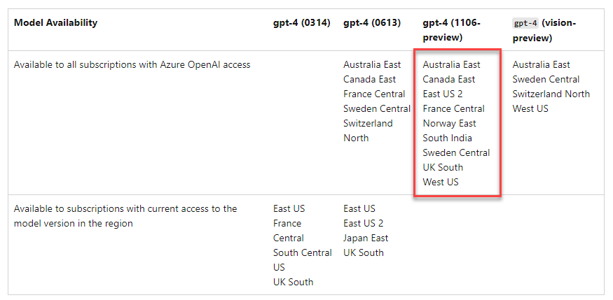
Choose an appropriate region
Notes:
Speaker notes:
You will work with the GPT-4 model in this training. This will limit the number of regions you can use for deployment. Review the region availability table (https://learn.microsoft.com/en-us/azure/ai-services/openai/concepts/models#model-summary-table-and-region-availability) and ensure that you choose a region that supports GPT-4.
Be sure to choose a region from this list! If you do not, you will may have access to the GPT-4 model for your deployments and will need to rely on GPT-3.5.

Slide 8
Azure OpenAI Service Models
Azure OpenAI contains several models with different capabilities and price points.
The primary models include:
GPT-3.5 – Understand and generate natural language and code
GPT-4 – Solve problems with greater accuracy than GPT-3.5. NOT available in all regions today!
Embeddings – Good for text search, text similarity, and code search
DALL-E – Generate images from text prompts
Whisper – Perform speech to text
Text to Speech – Synthesize text into speech
Notes:
Speaker notes:
There are several service models that make up the Azure OpenAI offering. The two workhorse models are GPT-3.5 and GPT-4. These models both understand and generate natural language and code. GPT-4 is the most recent generation of the GPT series and has 1.76 trillion parameters versus GPT-3.5's approximately 375 billion parameters. GPT-4 is not available in all regions, so please make sure to deploy your Azure OpenAI service into a region supporting GPT-4 for the exercises. Otherwise, you can perform the exercises but will be limited to ChatGPT-3.5 turbo.
Azure OpenAI contains one embedding model: text-embedding-ada-002. Historically, there were a series of embedding models specializing in different activities, such as text search, comparing two texts, and searching within code. With text-embedding-ada-002, we have a single model that covers all of these use cases.
There are three other service models. DALL-E allows us to generate images from text prompts. There are also services that perform speech to text and text to speech.

Slide 9
Add chat with data

Slide 10

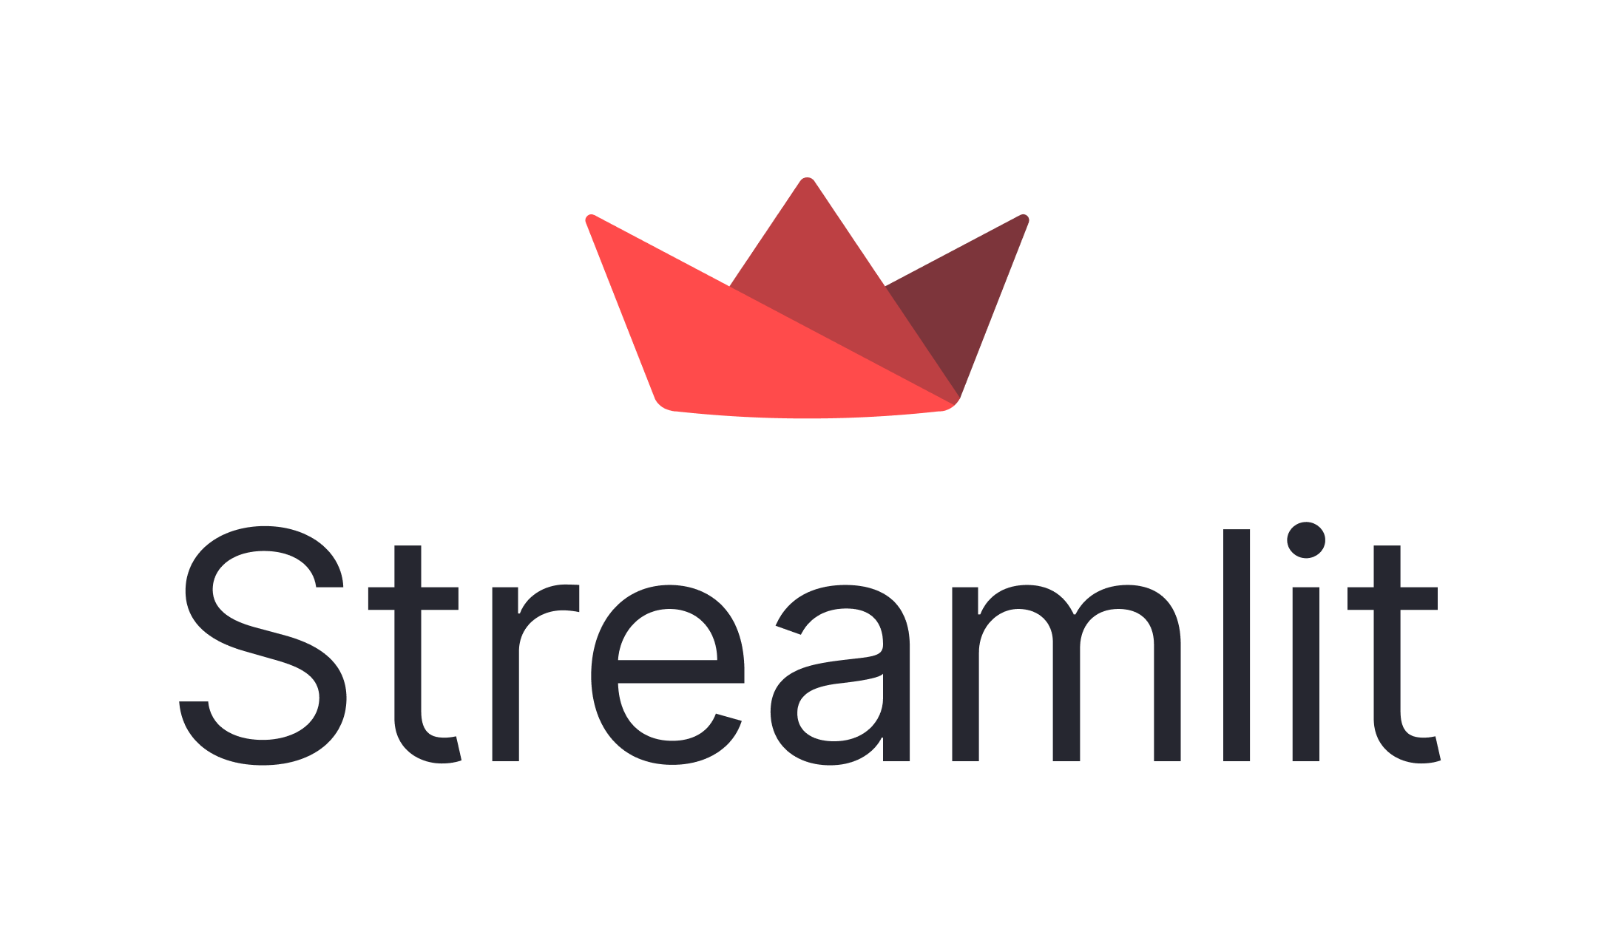
Exercise 2 Architecture
Storage Account
Resorts.txt
AI Search
Hotels.txt
Azure OpenAI
Notes:
This lab will focus around resort and hotel information. You will upload customer data into a storage account and process it using Azure AI Search. From there, you will be able to ask questions of the data in the Azure OpenAI Studio Chat Playground, as well as through the Azure OpenAI API in a Streamlit application.

Slide 11
Introduction: Add chat with data
In this lab, you’ll begin by uploading files into Azure Blob Storage. Then, you will perform data ingestion and vectorization in Azure AI Search. Finally, you will perform chat with data in a Streamlit app.
After completing this lab, you’ll be able to:
Prepare a dataset in Azure Blob Storage for ingestion into Azure OpenAI
Ingest data from Azure Blob Storage into Azure OpenAI via Azure AI Search
Test completions using the Chat Playground in Azure OpenAI
Incorporate chat completions in a Streamlit application
Notes:
Speaker notes:
One of the most natural ways to integrate Azure OpenAI in an existing solution is to incorporate chat into an existing system. For this solution to bring the most value to an organization, however, the chat service must have access to information that may be proprietary or otherwise confidential. In this exercise, we will add custom data to augment an existing Azure OpenAI chat deployment, allowing customer service agents to review customer data in a natural language format.
Learning objectives
After completing this lab, you'll be able to:
Prepare a dataset in Azure Blob Storage for ingestion into Azure OpenAI
Ingest data from Azure Blob Storage into Azure OpenAI via Azure AI Search
Test chat completions using the Chat Playground in Azure OpenAI
Incorporate chat completions into a Streamlit application

Slide 12
Add Your Data
Supported data sources
Azure Blob Storage
Local file upload (into Azure Blob Storage)
Azure AI Search indexes
Azure Cosmos DB for MongoDB vCore
Supported data types
Delimited text (.txt)
Markdown
HTML
Word
PowerPoint
PDF
Notes:
Speaker notes:
Azure OpenAI allows us to ingest data from several data sources. The key supported data source is data in Azure Blob Storage accounts. We can also upload files into a blob storage account for subsequent processing. This processing builds an index in Azure AI Search over your uploaded data, and that allows your GPT-3.5 or GPT-4 model deployment to provide responses based on your data.
This functionality will work for a specific set of data types, including delimited text files, Markdown, HTML files, Word documents, PowerPoint decks, and PDFs. Other data sources, such as hosting data in Azure SQL Database, is not supported at this time.

Slide 13
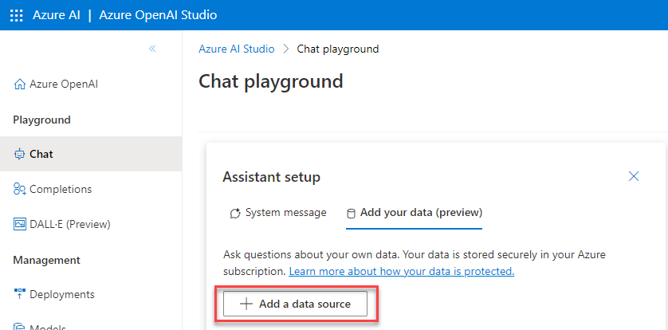
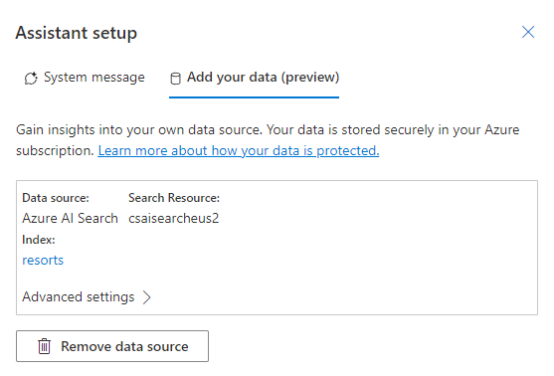
Add Your Data
Notes:
Speaker notes:
The Azure OpenAI Studio makes it easy to import data into Azure AI Search from Azure Blob Storage. From there, you can try chat completions against your data to ensure everything works as expected.

Slide 14
Streamlit
Python library
Intended for data scientists to build simple applications
Includes a variety of extensions and add-ons
Includes UI components for chat completions
Notes:
Speaker notes:
The client application we will use in this training is built on Streamlit, a Python library intended to make building data applications simple. You can build a functional Streamlit application in a few dozen lines of code, and there are even UI components to make chat completions easy.
Our goal in this training is to minimize the amount of time you spend fiddling with UI components, focusing instead on how we can integrate an existing application with Azure OpenAI.
Streamlit is certainly not the only way to access Azure OpenAI. You can write your own applications in a variety of programming languages, including but certainly not limited to C#, F#, JavaScript, Python, and Java. Several of these languages have full OpenAI or Azure OpenAI SDKs, whereas others will require you to make REST API calls.

Slide 15
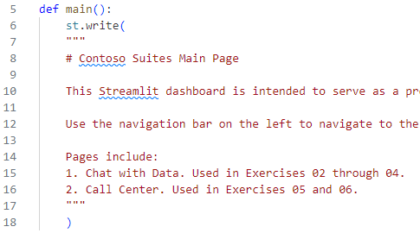
A Brief Overview of Streamlit Architecture
Code in the \src\ContosoSuitesDashboard\ folder
Index.py
pages\
1_Chat_with_Data.py
2_Call_Center.py
Index.py
Includes main() function
Notes:
Speaker notes:
All of the client code is in the source directory of the GitHub repository, located in a ContosoSuitesDashboard folder. Inside this folder is a file, index.py. This is the starting point for our Streamlit app. In addition, we have a folder called pages\, inside of which are two additional files. The first file covers chat with data and will be the focus of exercises 2 through 4. The second file covers a call center scenario; we will use it in exercises 5 and 6.
Inside the index.py file, we have a main() function that drives our application. We also have a write() function that writes text out to the screen.

Slide 16
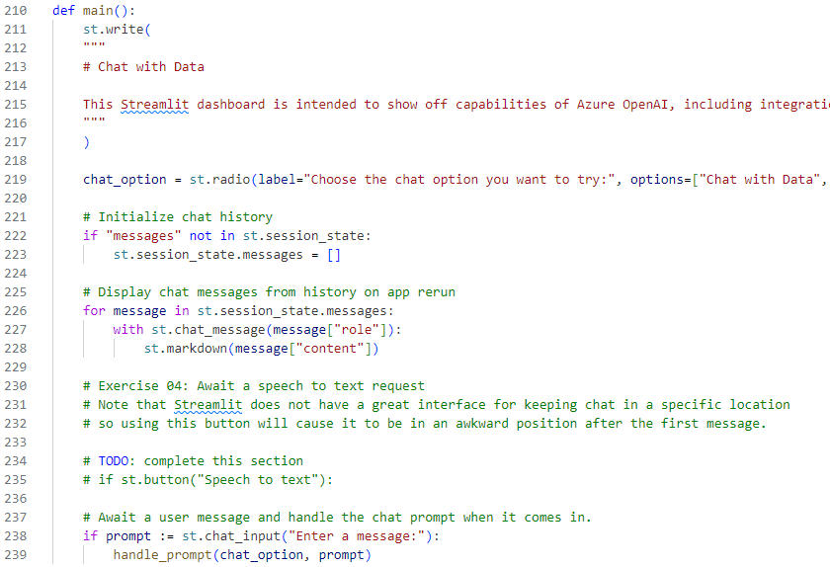
Chat with Data
Notes:
Speaker notes:
Just as with index.py, 1_Chat_with_Data.py script also includes a main() function that drives behavior. This function lays out the primary operation of the Chat with Data page. It makes use of session state in Streamlit, a way of retaining specific information across page refreshes. One key thing to know about Streamlit is that button clicks and many operations result in full page refreshes. In order to maintain a chat history, we need to store the history in session state, writing it back out on each page load.

Slide 17
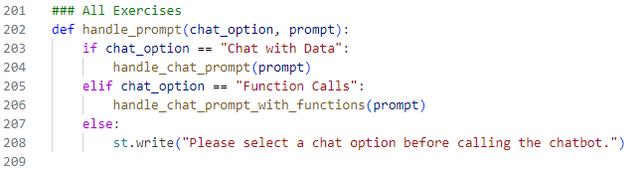
Chat with Data
Notes:
Speaker notes:
The handle_prompt() function is a simple function that allows us to perform chat with data (the goal of this exercise) or function calling (the goal of the next exercise).
The handle_chat_prompt() function is one of the functions that you will fill out during this exercise. The purpose of this function is to write the user's message into the chat history and then send the prompt to the Azure OpenAI service. The service will return a text response, though this response may come in multiple parts depending on your prompt. As the parts stream in, you will write them into chat, and once the call has totally completed, you will write the final output text into session state. This will create an impression of a continuous chat stream.

Slide 18
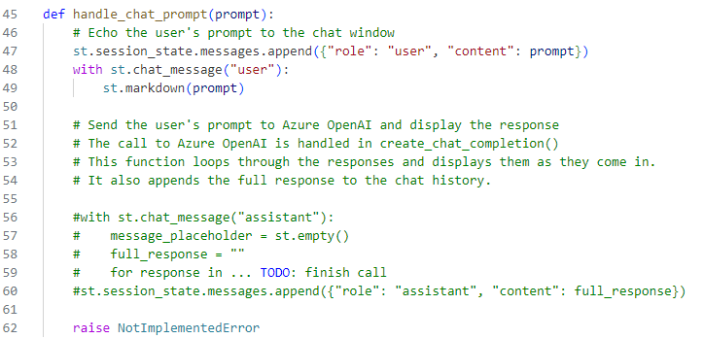
Chat with Data
Notes:
Speaker notes:
The handle_chat_prompt() function is one of the functions that you will fill out during this exercise. The purpose of this function is to write the user's message into the chat history and then send the prompt to the Azure OpenAI service. The service will return a text response, though this response may come in multiple parts depending on your prompt. As the parts stream in, you will write them into chat, and once the call has totally completed, you will write the final output text into session state. This will create an impression of a continuous chat stream.

Slide 19
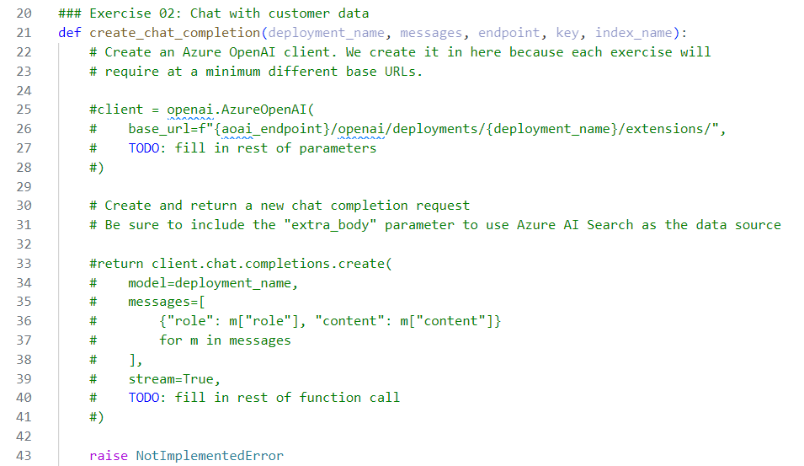
Update a Streamlit Application
Notes:
Speaker notes:
You will fill in the blanks on several existing functions in a Streamlit application.

Slide 20
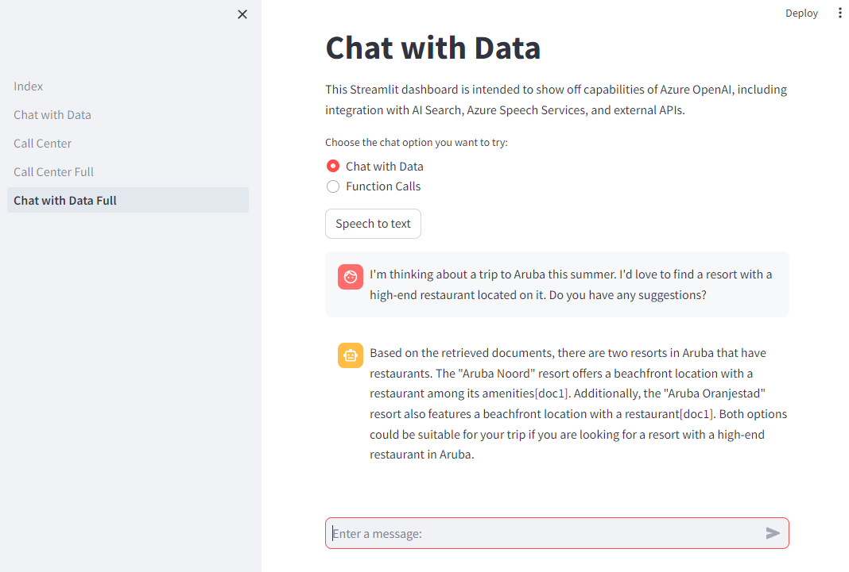
Chat with Data
Notes:
Speaker notes:
The end result is a dashboard that allows direct chat with your customer data.

Slide 21
Key Streamlit and Python Tips
Streamlit is a web service
Update process: save and refresh page
Whitespace matters!
Ensure spaces, not tabs
Keep consistent space numbers (typically 4 per level)
Notes:
Speaker notes:
Before we move into the exercise, here are a few tips to make the process of working with Streamlit easier for you. First, keep in mind that Streamlit is a web service and Python does not require code be compiled before execution. This means that, when you change a Python file, you can save the file changes and refresh the page. You do not need to stop and restart the Streamlit service.
Because all of our code is in Python, remember that whitespace does matter. Tabs and spaces are not the same thing in Python, and we highly encourage you to use spaces instead of tabs to prevent any oddities. Also, make sure that your code is aligned correctly. The general practice is to use 4 spaces per "level" of code. By following this practice, you will be able to avoid Python errors around invalid whitespace.
It may also be useful to write the code in an editor like Visual Studio Code, which includes support for formatter extensions (https://code.visualstudio.com/docs/python/editing#_formatting).

Slide 22
Implement function calls

Slide 23

Exercise 3 Architecture
Customers.json
Cosmos DB
Azure OpenAI
Web API (C#)
Function definitions
Function call defined
by GPT-4 deployment
Notes:
This exercise will focus on incorporating function definitions and executing function calls with a GPT-4 deployment as the intermediary. You will build an API endpoint in a .NET Web API. This endpoint will retrieve customer data from Cosmos DB based on some filter criteria.
You will make the GPT-4 deployment aware of this function using a function definition. Then, you can use the deployment to automate a function call and bring that data into Streamlit.

Slide 24
Introduction: Implement function calling against external APIs
In this lab, you’ll create a Web API endpoint for customer data. Then, you will build a function definition for the Azure OpenAI service and write Python code in Streamlit to tie everything together.
After completing this lab, you’ll be able to:
Implement a customer account information API endpoint against Cosmos DB using C#
Create a function in Python to perform customer account lookup as part of a broader conversation
Incorporate function calling into the existing chat completions solution
Notes:
Speaker notes:
Bringing our own data is one great way to enhance GPT models in Azure OpenAI, allowing them to answer questions specific to our circumstances. Another way to customize responses and enhance system capabilities involves function calling, a native way for GPT models to formula API calls and structure data outputs based on the functions we specify. In this exercise, you will create a function to supplement chat conversations with customer data.
Learning objectives
After completing this lab, you'll be able to:
Implement a customer account information lookup API endpoint against Cosmos DB using C#
Create a function in Python to perform customer account lookup as part of a broader conversation
Incorporate function calling into the existing chat completions solution

Slide 25
Build a Web API Endpoint
You will build a standard Web API service in C# that reads from data in Cosmos DB.
For the sake of simplicity, this service can run locally or you could deploy it to Azure.
public async Task<IEnumerable<Customer>> GetCustomersByName(string name)
{
var queryable = container.GetItemLinqQueryable<Customer>();
using FeedIterator<Customer> feed = queryable
.Where(c => c.FullName == name)
.ToFeedIterator<Customer>();
return await ExecuteQuery(feed);
}
The method above retrieves any customer whose full name matches the input string.
Notes:
Speaker notes:
A recent addition to Azure OpenAI is the ability to define function calls to external resources. To show this off to Contoso Suites, you will first create a simple Web API in C# and have it access data in Cosmos DB.

Slide 26
Function Calling
Produce structured JSON outputs based on functions you describe
High-level breakdown
Call the chat completions API with your functions and user input
Model response includes an API call
Make the API or function call
Call the chat completions API again, including results from function call
Notes:
Speaker notes:
Function calling is a recent addition to OpenAI and Azure OpenAI. Its main purpose is to allow users to integrate GPT-3.5 Turbo or GPT-4 models with external systems, including systems hidden from the public Internet on corporate networks or VNets. The GPT model deployment returns a structured JSON output based on functions you specify and the context of the user prompt, providing your code with the information necessary to make the appropriate API or function call.
At a high level, there are four major steps involved. First, we call the chat completions API, specifying the nature of the available functions in JSON format, including function names, parameters, and whether these parameters are required. We also send in user prompt in natural language, describing the task we wish to perform.
Based on these inputs, the model’s response will include an API call. We can take this intermediate response and make the API or function call. As a quick note, function calling happens from our own code on our own servers, so we do not need to expose any corporate APIs to Azure OpenAI servers. The response of this API or function call then forms the basis of the next prompt to the GPT model deployment, and the deployment can use this, as well as context from the prior call, to complete the request. The upshot of this is that we can customize what, exactly, a general-purpose Large Language Model can do.
A great example of function calling is performing math problems. We’ve all seen examples of ChatGPT failing to perform basic math problems correctly because, ultimately, GPT models are language models, not mathematical inference models. What we can do, however, is augment the language model with a library that can perform mathematical operations and use our language model as part of a user interface for the library.

Slide 27
Tips for Function Calling
Validate function calls
Use trusted data and tools
Follow the principle of least privilege
Consider real-world impact
Implement user confirmation steps
Notes:
Speaker notes:
Function calling does come with a few risks that we should work to mitigate. First, be sure to validate the function calls on two levels. The first level is to ensure that the function call is syntactically correct, including function call and parameter specification. The second level is to ensure that the function call is appropriate—that is, that the response is the correct function call given the circumstances.
Be sure to use trusted data and tools. Sanitize any direct user input to prevent malicious activity. Also, ensure that any external function or API calls you import are safe.
Grant only the minimum level of access necessary for the function o perform its job. For example, if you have a function to insert rows into a table in a database, do not grant that same account the right to drop tables.
When working with functions, consider the real-world impact of a function call. If your function call updates a database, how easy (or difficult) would it be to track why a particular database update occurred, and what are the actual consequences of that update? Is there a financial or personal risk associated with this call?
If there are potential risks, it can make sense to implement user confirmation steps, which might even include the text of the function call the code is about to make. This way, a human with appropriate authority and situational knowledge may be able to prevent a harmful action from taking place.

Slide 28
Create a Function Definition
You will then tell the Azure OpenAI service about any available functions, including input parameters, data types, and required inputs.
This is an example of a function definition.
functions = [
{
"name": "get_widgets",
"description": "Get widgets by owner",
"parameters": {
"type": "object",
"properties": {
"owner": {"type": "string"},
},
"required": ["owner"],
},
}
]
Notes:
Speaker notes:
Once your Web API service is running, you can define function calls in your Python code. For example, this get_widgets() would call a local function in Streamlit named get_widgets(). That local function could then reference an external API and bring back data.

Slide 29
Implement audio transcription

Slide 30


Exercise 4 Architecture
AI Services Speech
Azure OpenAI
Notes:
This exercise will incorporate speech to text. You will use a microphone to state an utterance and then send that to the AI Services Speech service for recognition. From there, you will submit the text to Azure Open AI for chat completion. You will do this in the Azure OpenAI Studio Chat Playground as well as from a Streamlit application.

Slide 31
Introduction: Implement audio transcription
In this exercise, you’ll create an Azure AI Services Speech service and use it to transcribe utterances from your microphone into chat completion requests in Azure OpenAI.
After completing this lab, you’ll be able to:
Create an Azure AI Services Speech service and test it using the OpenAI Studio Chat playground
Incorporate speech to text into the existing chat completions solution
Notes:
Speaker notes:
To this point, we have shown Contoso Suites some of the benefit of chat completions with the Azure OpenAI service. In this exercise, we will extend from text to include spoken requests as well.
Learning objectives
After completing this lab, you'll be able to:
Create an Azure AI Services Speech service and test it using the OpenAI Studio Chat playground
Incorporate speech to text into the existing chat completions solution

Slide 32
Azure AI Services Speech Service
Provide speech-to-text and text-to-speech capabilities
Key scenarios
Captioning
Transcription
Speaker recognition
Creation of audio content
Create voice assistants
Notes:
Speaker notes:
The Azure AI Services Speech service provides two key capabilities. The first is translating speech to text, and the second is translating text to speech. Two common use cases for speech-to-text processing are captioning videos and creating transcripts of calls and meetings. We can also use speech-to-text to recognize speakers, improving the quality of transcripts when there are multiple people speaking. For the text-to-speech scenario, we can create audio content and even voice assistants using the service.
In this training, we will focus on the speech-to-text scenario.

Slide 33
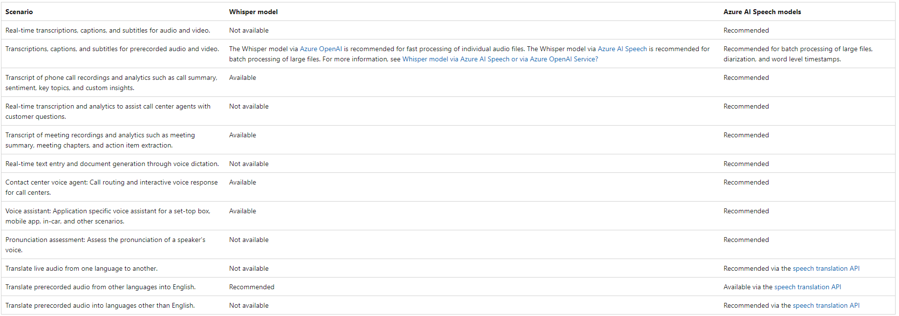
Whisper API vs AI Services Speech
Notes:
Speaker notes:
Azure OpenAI includes the Whisper API, which supports audio transcription. For that reason, knowledgeable users may ask, why use Azure AI Services here instead of sticking with Azure OpenAI? The reason is that the Whisper service has a separate intent from Azure AI Speech. Whisper’s primary use case is for processing audio files rather than real-time or live audio processing. For closer to real-time processing scenarios or the processing of large batch files, the Azure AI Speech service is typically a better choice.

Slide 34
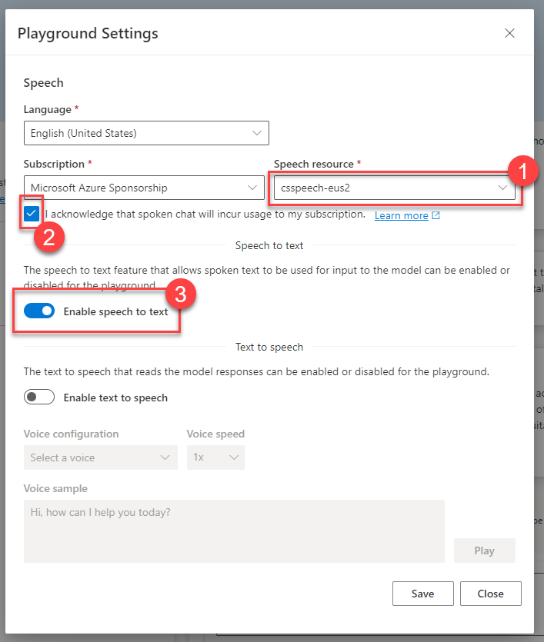
Prepare a speech resource
The Azure OpenAI Studio has built-in support for AI Services Speech resources.
You will work with a speech to text scenario in this exercise, but text to speech is also a possibility.
Notes:
Speaker notes:
The Azure OpenAI Studio has built-in support for AI Services Speech service resources. You will create an AI Services Speech resource in the same region as your Azure OpenAI service and enable speech to text in the OpenAI Studio Chat Playground.

Slide 35
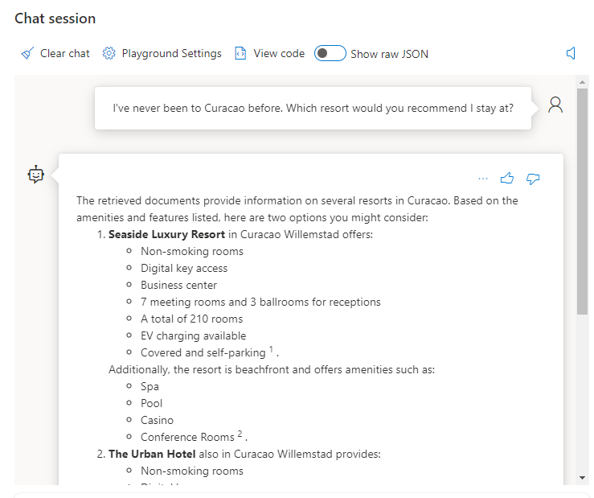
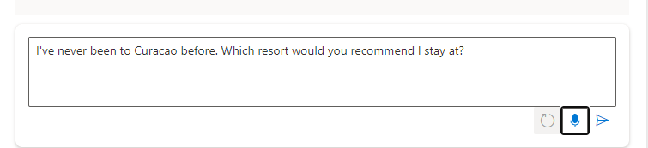
Make Requests using Speech
Notes:
Speaker notes:
When you select the microphone option, you will be able to speak your request. The speech to text service interprets your request as an utterance. You can then send the interpreted message and receive a response as though you typed in the message.
You will implement similar functionality in the Streamlit application as well.

Slide 36
Provide live audio transcription
Exercise 5

Slide 37

Exercise 5 Architecture
AI Services Speech
Azure OpenAI
Notes:
Exercise 5 focuses on audio transcription. You will perform speech-to-text analysis of pre-recorded calls as well as your microphone input. You will then build a simple mechanism to check if a call meets compliance requirements.

Slide 38
Introduction: Provide live audio transcription
In this lab, you will enable users to upload audio files or stream input from their microphone. The audio will go through the AI Services Speech service, which will transform that audio to text. You will also implement a simple form of compliance checking on the audio to ensure it meets policy requirements for Contoso Suites.
After completing this lab, you’ll be able to:
Configure branching in GitHub
Setup protected branches
Setup a GitHub security policy
Configure code security and vulnerability scanning
Create app monitoring dashboards
Configure app availability monitoring
Notes:
Speaker notes:
In the prior exercise, you captured an utterance and submitted it to the Azure AI Services Speech service for speech to text transcription. From there, you submitted that text as an input to a chat client.
In this exercise, you will enable users to upload audio files or stream input from their microphone. The audio will go through the AI Services Speech service, which will transform that audio to text. You will also implement a simple form of compliance checking on the audio to ensure it meets policy requirements for Contoso Suites.
Learning objectives
After completing this lab, you'll be able to:
Incorporate audio file upload and audio transcription into a Streamlit app
Incorporate live microphone transcription of a full audio stream into a Streamlit app
Check whether a call meets compliance requirements

Slide 39
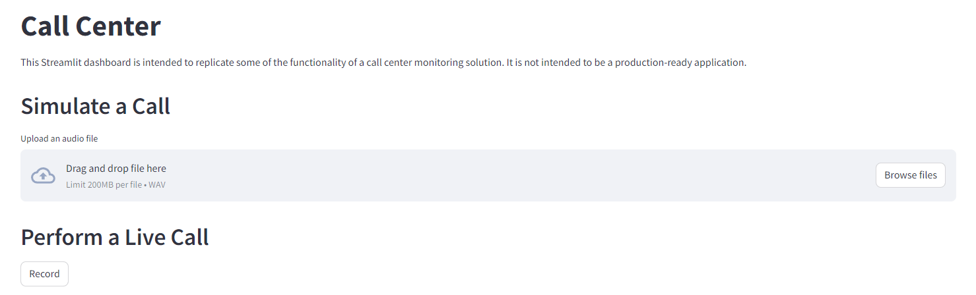
Call Simulation
Use the st.file_uploader() widget in Streamlit to accept file uploads, or use a button to perform call recording.
Notes:
Speaker notes:
Streamlit has a built-in capability for file uploads, using the st.file_uploader() widget. You will use this to capture an audio file in WAV format and submit it to the AI Services Speech service for transcription.
You will also use a Streamlit Extras stateful button to perform live call recording, enabling you to speak into a microphone and stream that data to Azure AI Services for transcription.

Slide 40
Audio File Metadata
Each audio file has a few important attributes.
Audio file metadata attributes:
Number of channels
Bit depth
Sample rate (KHz)
Notes:
Speaker notes:
Each digital audio file has three attributes we care about: channels, bit depth, and sample rate.
The number of channels represents the number of recorded waveforms in our audio file. These channels allow us to simulate depth. We may, for example, use two channels in stereo sound: one channel for the speaker on the left and one for the speaker on the right.
The number of bits per sample is also known as the bit depth. It lets us track the amplitude of a waveform, and more bits per sample means a higher gradation in volume levels, but at the cost of larger files.
Finally, the sample rate is something we usually measure in kilohertz, where one hertz is one per second. A sample rate of 44.1 kilohertz and bit depth of 16 means we have 44,100 samples of 16 bits per second.
This is important because the Azure AI Services Speech service needs to know the proper values for channels, bit depth, and sample rate. If we send in incorrect values, we will end up with improper translations of audio files, as we will see in the exercise. Fortunately, it is easy to read file metadata to know what the proper values should be, so the likelihood of running into a problem in practice is low.

Slide 41
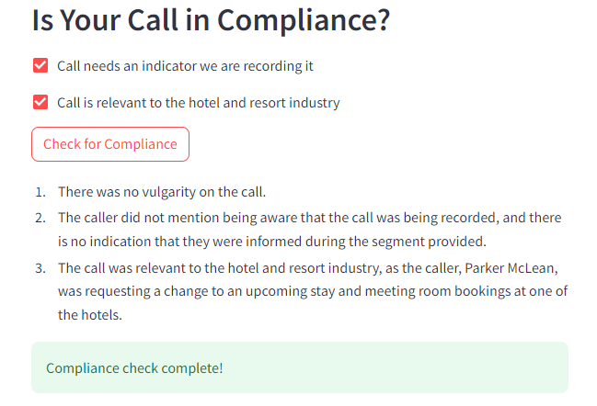
Call compliance
You will build a simple set of compliance checks for Contoso Suites.
In this procedure, you will create checks regarding:
Whether the call transcript contains vulgarity
Whether the call has an indicator that we are recording it for training or quality assurance purposes (optional)
Whether the call is relevant to Contoso Suites: if it is related to the hotel and resort industry (optional)
Notes:
Speaker notes:
You will implement a simple set of compliance checks for Contoso Suites. One of the three checks, whether the call transcript contains vulgarity, will be mandatory. The other two are optional. The first optional check is whether the call has an indicator that we are recording it for training or quality assurance purposes. This is usually a statement you may hear when calling a support line and it serves as affirmation that both parties accept that this call may be recorded. Depending upon the jurisdiction of the callers, this may be legally required in order to record a call.
The other optional check is whether the call is relevant to Contoso Suites inasmuch as it pertains to the hotel and resort industry.

Slide 42
Generate a call summary
Exercise 6

Slide 43


Exercise 6 Architecture
Summarization
Extractive & Abstractive Summarization with Azure AI Language
Query-based Summarization
with Azure OpenAI
Azure AI
Language
Azure OpenAI
Named Entity Extraction
Sentiment Analysis & Opinion Mining
Azure AI
Language
Azure AI
Speech
Call transcription
Notes:
Exercise 6 focuses on using generative AI to summarize text and to extract insights. You will use Azure AI Services and Azure OpenAI to generate summaries of a call transcript, using three different summarization methods (extractive, abstractive, and query-based), and then evaluate the output of each method. You will then use the Azure AI Language service to extract various insights from the call transcript, include assessing the sentiment of the call, performing opinion mining, and extracting named entities.

Slide 44
Introduction: Use Azure AI Services to generate call summaries and extract insights
In this lab, you will expand on the audio transcription work you did in lab 05, focusing on using Azure AI Services--including Azure OpenAI--to summarize the call's transcript and to extract insights from the transcript. You will also preform sentiment analysis and opinion mining.
After completing this lab, you’ll be able to:
Generate summaries using various methods available in Azure AI Services and Azure OpenAI
Use Azure AI Language to extract named entities
Leverage Azure AI Language to perform sentiment analysis and opinion mining
Incorporate call summarization into a Streamlit app
Notes:
Speaker notes:
Now that you have assisted Contoso Suites with automating the creation of audio transcriptions, they would like to leverage Azure AI Services to automate the generation of a call summary, eliminating the need for their customer service agents to do this manually at the end of each call.
In this lab, you will expand on the audio transcription work you did in Lab 05, focusing on using Azure AI Services--including Azure OpenAI--to summarize the call's transcript and to extract insights from the transcript. You will also preform sentiment analysis and opinion mining.
Learning objectives
After completing this lab, you'll be able to:
Generate summaries using various methods available in Azure AI Services and Azure OpenAI. Summarization methods include extractive, abstractive, and query-based summaries.
Use Azure AI Services to extract named entities
Leverage Azure AI Services to perform sentiment analysis and opinion mining
Incorporate call summarization into a Streamlit app

Slide 45
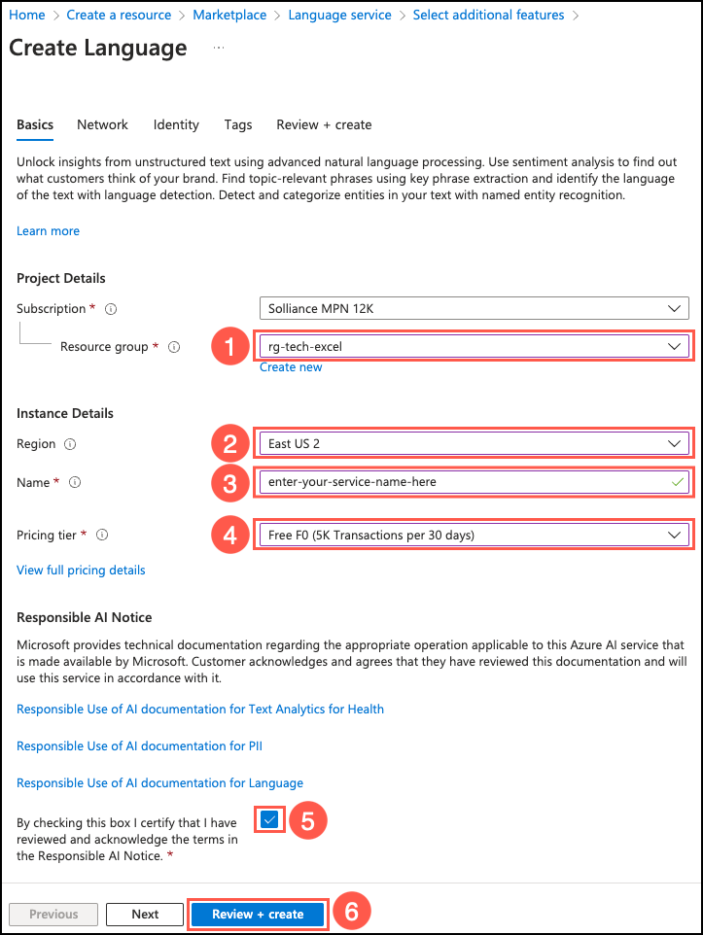
Prepare a language resource
The Azure AI Language service provides numerous capabilities for extracting information and insights from text.
You will use the Language service to summarize text, extract named entities, and perform sentiment analysis and opinion mining.
Notes:
Speaker notes:
You will create an AI Services Language resource in the same region as your Azure OpenAI service to allow for working with different methods of text summarization. You will also use the service to extract named entities and perform sentiment analysis and opinion mining.

Slide 46
Azure AI Language service
Named Entity Recognition (NER) and Custom Named Entity Recognition (Custom NER)
Personally identifying (PII) and health (PHI) information detection
Language detection
Sentiment analysis and opinion mining
Summarization
Key phrase extraction
Entity linking
Text analytics for health and Custom text analytics for health
Custom text classification
Conversational language understanding
Question answering
Notes:
Speaker notes:
The Azure AI Language is a cloud-based service that provides Natural Language Processing (NLP) features for understanding and analyzing text. The Language service brings together multiple capabilities, including:
Named Entity Recognition (NER) and Custom Named Entity Recognition (Custom NER): This feature is used to categorize entities (words or phrases) in unstructured text across predefined category groups, such as people, places, events, and dates.
Personally identifying (PII) and health (PHI) information detection: Identifies, categorizes, and redacts sensitive information from text. Examples include phone numbers, email addresses, and forms of identification.
Language detection: Detects the language in which a document is written.
Sentiment analysis and opinion mining: Helps you determine what people think of a topic by mining text for clues about positive or negative sentiment.
Summarization: Produces a summary of text.
Key phrase extraction: Evaluates and returns the main concepts in unstructured text.
Entity linking: Disambiguates the identity (words or phrases) found in text and returns links to Wikipedia.
Text analytics for health and Custom text analytics for health: Extracts and labels relevant medical information from text, such as doctor’s notes, clinical documents, and electronic health records.
Custom text classification: Enables you to build custom AI models to classify unstructured text documents into classes you define.
Conversational language understanding: Enables you to build custom natural language understanding models.
Question answering: Finds the most appropriate answer for inputs from users.
In this lab, we will focus on Summarization, Sentiment analysis and opinion mining, and Named Entity Recognition (NER).

Slide 47
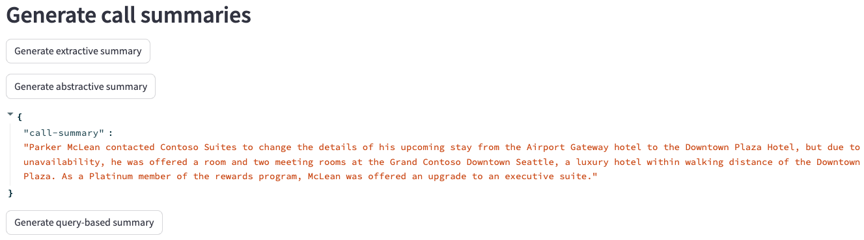
Call Summarization
Using Azure AI Language service and Azure OpenAI, you will use three different techniques for generating summaries of a call transcript.
Extractive
Abstractive
Query-based
Notes:
Speaker notes:
Summarization is a technique in which AI is leveraged to produce a summary of a document or conversation transcription. Text summarization is designed to shorten content that users consider too long to read. AI-based summarization focuses on highlighting the most important aspects of the text. Azure AI Services provide several mechanism for summarizing text. There are three primary techniques used for performing summarization:
The Language service provides the first two methods, extractive and abstractive summarization functions, both of which condense text or documents into key sentences.
- Extractive summarization: Extractive summarization is a method in which the AI evaluates text to ascertain the key concepts and ideas it represents. A summary is created by extracting the sentences that collectively represent the most important or relevant information within the original content.
- Abstractive summarization: Abstractive summarization follows a similar pattern of using AI to evaluate the most important information with the original content but differs in that it produces a summary by generating new, original sentences from the document that capture the main idea.
Azure OpenAI provides the third summarization method:
- Query-based summarization: Query-based summarization leverages generative AI and large language models (LLMs), such as gpt-4.0 provided by Azure OpenAI, to create a summary based on the key ideas within text. For query-based summarization, you will provide the LLM with the natural language instructions it requires to identify the task you want it to perform, using a process known as prompt engineering.

Slide 48
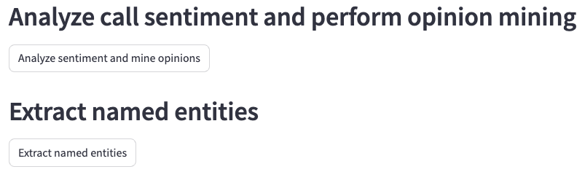
Extract insights
You will use features of Azure AI Language to extract insights from a call transcript.
In this task, you will extract insights using the Azure AI Language service:
Analyze sentiment of the call
Mine opinions
Extract named entities
Notes:
Speaker notes:
Azure AI Language is a cloud-based service that provides Natural Language Processing (NLP) features for understanding and analyzing text. In the last task, you used the Azure AI Language service for text summarization. You will take the analysis at step further in this task, extracting named entities and performing sentiment analysis and opinion mining over the same call transcript.
- Sentiment analysis and opinion mining are features that help you assess what people think of your brand or topic by mining text for clues about positive or negative sentiment and can associate them with specific aspects of the text.
- Named entity recognition (NER) categorizes entities (words or phrases) in unstructured text across several predefined category groups. For example: people, events, places, and dates.
In this task, you will leverage your Azure AI Language service to extract insights from a call transcript. You will start by analyzing the sentiment of the transcript and performing opinion mining against the text. You will then extract named entities from the transcript.

